Slide 1
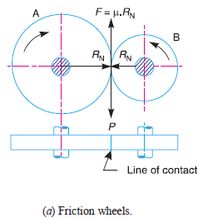
Theory of machines Wessam Al Azzawi
Toothed Gearing
We have discussed in the previous chapter, that the slipping of a belt or rope is a common phenomenon, in the transmission of motion or power between two shafts. The effect of slipping is to reduce the velocity ratio of the system. In precision machines, in which a definite velocity ratio is of importance (as in watch mechanism), the only positive drive is by means of gears or toothed wheels. A gear drive is also provided, when the distance between the driver and the follower is very small.
In order to understand how the motion can be transmitted by two toothed wheels, consider two plain circular wheels A and B mounted on shafts, having sufficient rough surfaces and pressing against each other as shown in Fig.(a).

Slide 2
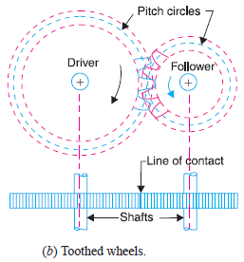
Theory of machines Wessam Al Azzawi
when the tangential force (P) exceeds the *frictional resistance (F), slipping will take place between the two wheels. Thus the
friction drive is not a positive drive.
In order to avoid the slipping, a number of teeth as shown in Fig.(b), are provided on the periphery of the wheel A, which will fit into the corresponding teeth on the wheel B. A friction wheel with the teeth cut on it is known as toothed wheel or gear.
Advantages and Disadvantages of Gear Drive
Advantages
1. It transmits exact velocity ratio.
2. It may be used to transmit large power.
3. It has high efficiency.
4. It has reliable service.
5. It has compact layout.
Disadvantages
1. The manufacture of gears require special tools and equipment.
2. The error in cutting teeth may cause vibrations and noise during operation.

Slide 3
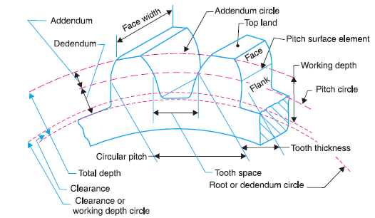
Theory of machines Wessam Al Azzawi
Terms Used in Gears
1. Pitch circle. It is an imaginary circle which by pure rolling action, would give the same
motion as the actual gear.
2. Pitch circle diameter. It is the diameter of the pitch circle.
3. Pitch point. It is a common point of contact between two pitch circles.
4. Pitch surface. It is the surface of the rolling discs which the meshing gears have replaced
at the pitch circle.

Slide 4
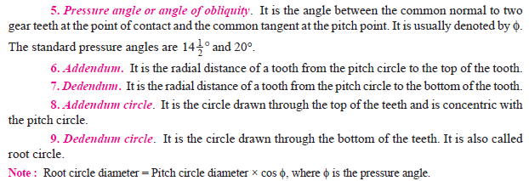
Theory of machines Wessam Al Azzawi

Slide 5
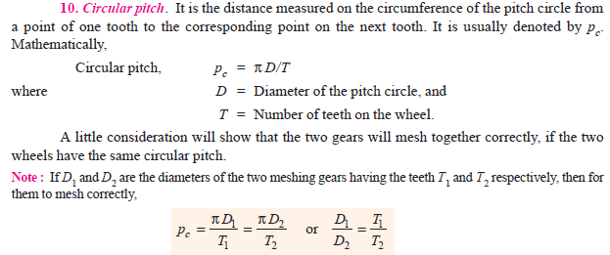
Theory of machines Wessam Al Azzawi

Slide 6
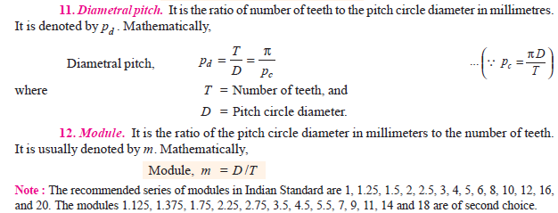
Theory of machines Wessam Al Azzawi

Slide 7
Theory of machines Wessam Al Azzawi

Slide 8
Theory of machines Wessam Al Azzawi

Slide 9
Theory of machines Wessam Al Azzawi

Slide 10
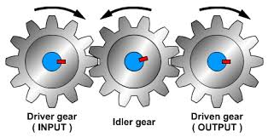
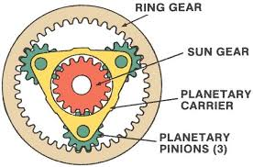
Theory of machines Wessam Al Azzawi
Gears Trains
Sometimes, two or more gears are made to mesh with each other to transmit power from one shaft to another. Such a combination is called gear train or train of toothed wheels.
There are different types of gear trains, depending upon the arrangement :
Simple gear train
Compound gear train
Reverted gear train
Epicyclic gear train.
In the first three types of gear trains, the axes of the shafts over which the gears are mounted are fixed relative to each other.
In case of epicyclic gear trains, the axes of the shafts on which
the gears are mounted may move relative to a fixed axis.

Slide 11
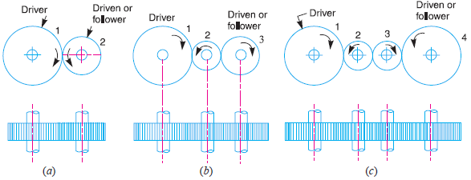
Theory of machines Wessam Al Azzawi
Simple Gear Train
When there is only one gear on each shaft, as shown in Fig.1, it is known as simple gear train.
Sometimes, the distance between the two gears is large in such a case, motion may be transmitted by:
1. Providing large sized gear, or 2. Providing one or more intermediate gears.
Providing large sized gears is very inconvenient and uneconomical method ; whereas providing one or more intermediate gear is very convenient and economical.

Slide 12
Theory of machines Wessam Al Azzawi
when the number of intermediate gears are odd, the motion of the driver and driven is like Fig. (b). But when the number is even, the motion of the driven will be in the opposite direction of the driver Fig. (c).
Now consider a simple train of gears with one intermediate gear as shown in Fig.(b). Let N₁ = Speed of driver in r.p.m.,
N₂ = Speed of intermediate gear in r.p.m.,
N₃ = Speed of driven or follower in r.p.m.,
T₁ = Number of teeth on driver,
T₂ = Number of teeth on intermediate gear, and
T₃ = Number of teeth on driven or follower.
Since the driving gear 1 is in mesh with the intermediate gear 2, therefore speed ratio for these two gears is

Slide 13
Theory of machines Wessam Al Azzawi
by multiplying the equations (i) and (ii).
The intermediate gears are called idle gears, as they do not effect the speed ratio or train value of the system.

Slide 14
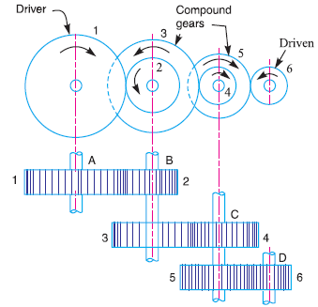
Theory of machines Wessam Al Azzawi
Compound Gear Train
When there are more than one gear on a shaft, as shown in Fig.2, it is called a compound train of gear.
whenever the distance between the driver and the driven or follower has to be bridged over by intermediate gears and at the same time a speed ratio is required, then compound gears on intermediate shafts is required. In this case, each intermediate shaft has two gears rigidly fixed to it so that they have the same speed. One of these two gears meshes with the driver and the other with the driven or follower

Slide 15
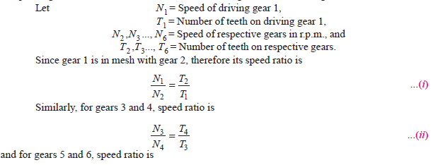
Theory o++ f machines Wessam Al Azzawi
gear 1 is the driving gear mounted on shaft A, gears 2 and 3 are compound gears which are mounted on shaft B. The gears 4 and 5 are also compound gears which are mounted on shaft C and the gear 6 is the driven gear mounted on shaft D.

Slide 16
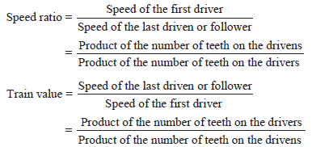
Theory o++ f machines Wessam Al Azzawi

Slide 17
Theory of machines Wessam Al Azzawi
The advantage of a compound train over a simple gear train is that a much larger speed reduction from the first shaft to the last shaft can be obtained. If a simple gear train is used to give a large speed reduction, the last gear has to be very large. Usually for a speed reduction in excess of 7 to 1, a simple train is not used and a compound train is employed.

Slide 18
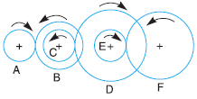
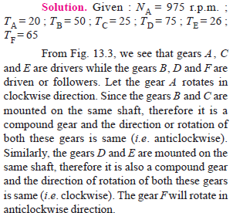
Theory of machines Wessam Al Azzawi
Example 1. The gearing of a machine tool is shown in Fig.3. The motor shaft is connected to gear A and rotates at 975 r.p.m. The gear wheels B, C, D and E are fixed to parallel shafts rotating together. The final gear F is fixed on the output shaft. What is the speed of gear F ? The number of teeth on each gear are as given below :

Slide 19
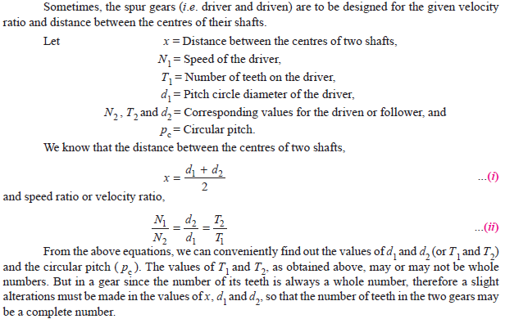
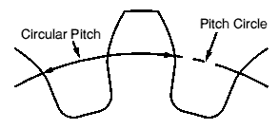
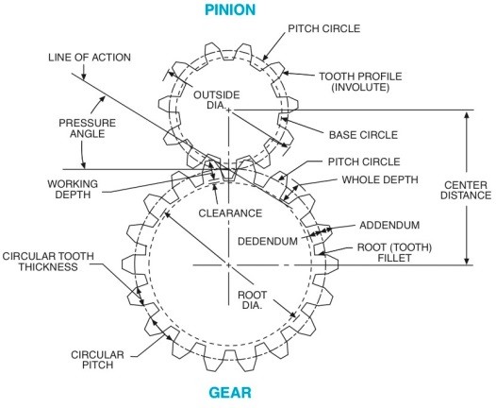
Theory of machines Wessam Al Azzawi
Design of Spur Gears

Slide 20
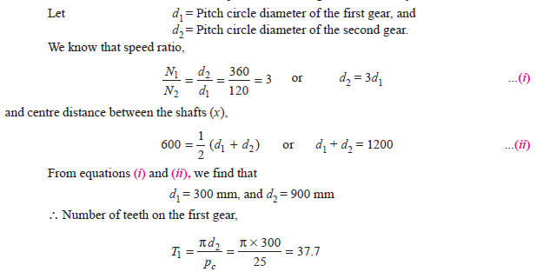
Theory of machines Wessam Al Azzawi
Example. 2:Two parallel shafts, about 600 mm apart are to be connected by spur gears.
One shaft is to run at 360 r.p.m. and the other at 120 r.p.m. Design the gears, if the circular pitch is to be 25 mm.
Solution. Given : x = 600 mm ; N1 = 360 r.p.m. ; N2 = 120 r.p.m. ; pc = 25 mm

Slide 21
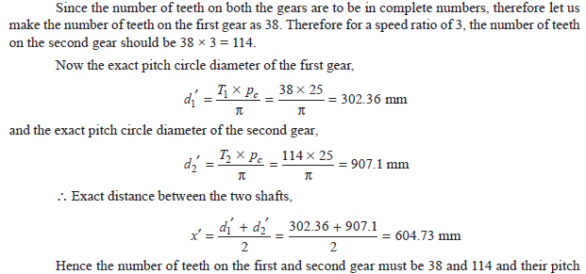
Theory of machines Wessam Al Azzawi

Slide 22
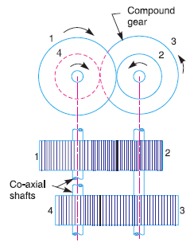
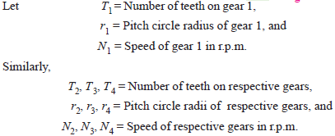
Theory of machines Wessam Al Azzawi
Reverted Gear Train
When the axes of the first driver and the last driven are co-axial, then the gear train is known as reverted gear train as shown in Fig. 4. We see that gear 1 drives the gear 2 in the opposite direction. Since the gears 2 and 3 are mounted on the same shaft, therefore they form a compound gear and the gear 3 will rotate in the same direction as that of gear 2. The gear 3 (which is now the second driver) drives the gear 4 in the same direction as that of gear 1. Thus we see that in a reverted gear train, the motion of the first gear and the last gear is like.
Fig.4

Slide 23
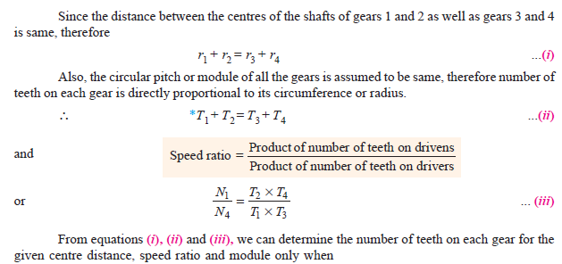
Theory of machines Wessam Al Azzawi
Reverted Gear Train
Fig.4

Slide 24
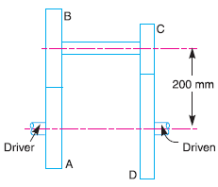
Theory of machines Wessam Al Azzawi
Example 3. The speed ratio of the reverted gear train,
as shown in Fig.5, is to be 12. The module pitch of gears A
and B is 3.125 mm and of gears C and D is 2.5 mm. Calculate the suitable numbers of teeth for the gears. No gear is to have less than 24 teeth.
Solution. Given : Speed ratio, NA/ND = 12 ;
mA = mB = 3.125 mm ; mC = mD = 2.5 mm
Let NA = Speed of gear A,
TA = Number of teeth on gear A,
rA = Pitch circle radius of gear A,
NB, NC , ND = Speed of respective gears,
TB, TC , TD = Number of teeth on respective gears, and
rB, rC , rD = Pitch circle radii of respective gears.
Fig.5

Slide 25
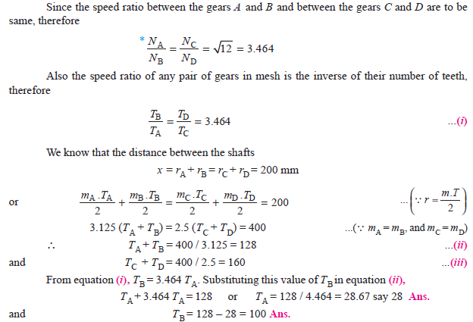
Theory of machines Wessam Al Azzawi
Fig.5

Slide 26
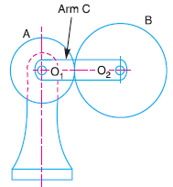
Theory of machines Wessam Al Azzawi
Epicyclic Gear Train
We have already discussed that in an epicyclic gear train, the axes of the shafts, over which the gears are mounted, may move relative to a fixed axis. A simple epicyclic gear train is shown in Fig.6, where a gear A and the arm C have a common axis at O₁ about which they can rotate. The gear B meshes with gear A and has its axis on the arm at O₂, about which the gear B can rotate.
If the arm is fixed, the gear train is simple and gear A can drive gear B or vice- versa, but if gear A is fixed and the arm is rotated about the axis of gear A (i.e. O₁), then the gear B is forced to rotate upon and around gear A. Such a motion is called epicyclic and the gear trains arranged in such a manner that one or more of their members move upon and around another member are known as epicyclic gear trains (epi. means upon and cyclic means around). The epicyclic gear trains may be simple or compound.
Fig.6

Slide 27
Theory of machines Wessam Al Azzawi
Velocity Ratios of Epicyclic Gear Train
The following two methods may be used for finding out the velocity ratio of an epicyclic
gear train.
Tabular method
Algebraic method.
1. Tabular method
Consider an epicyclic gear train as shown in Fig. 13.6.
Let TA = Number of teeth on gear A, and
TB = Number of teeth on gear B.
let us suppose that the arm is fixed. Therefore the axes of both the gears are also fixed relative to each other. When the gear A makes one revolution anticlockwise, the gear B will make TA / TB revolutions, clockwise. Assuming the anticlockwise rotation as positive and clockwise as negative, we may say that when gear A makes + 1 revolution, then the gear B will make (– TA / TB) revolutions. This statement of relative motion is entered in the first row of the table (see Table.1).
Fig.6

Slide 28
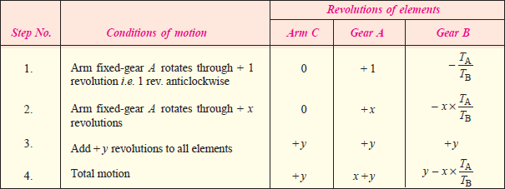
Theory of machines Wessam Al Azzawi
Each element of an epicyclic train is given + y revolutions and entered in the third row. Finally, the motion of each element of the gear train is added up and entered in the fourth row.
When two conditions about the motion of rotation of any two elements are known, then the unknown speed of the third element may be obtained by substituting the given data in the third column of the fourth row.
Table.1
If the gear A makes + x revolutions, then the gear B will make – x × TA / TB revolutions. This statement is entered in the second row of the table. In other words, multiply the each motion (entered in the first row) by x.
Fig.6

Slide 29
Theory of machines Wessam Al Azzawi
2. Algebraic method
In this method, the motion of each element of the epicyclic train relative to the arm is set down in the form of equations. The number of equations depends upon the number of elements in the gear train. But the two conditions are, usually, supplied in any epicyclic train viz. some element is fixed and the other has specified motion. These two conditions are sufficient to solve all the equations ; and hence to determine the motion of any element in the epicyclic gear train.
Let the arm C be fixed in an epicyclic gear train as shown in Fig.6. The speed of the gear A relative to the arm C
= NA – NC
and speed of the gear B relative to the arm C,
= NB – NC
Since the gears A and B are meshing directly, therefore they
will revolve in opposite directions.
Fig.6

Slide 30
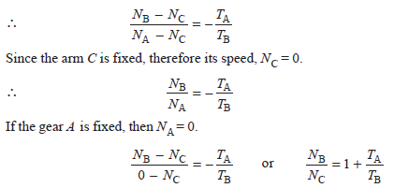
Theory of machines Wessam Al Azzawi
Fig.6

Slide 31
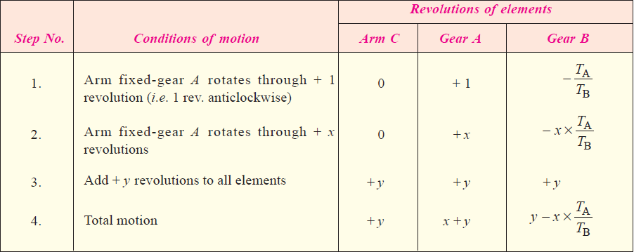
Theory of machines Wessam Al Azzawi
1. Tabular method
First of all prepare the table of motions as given below :

Slide 32
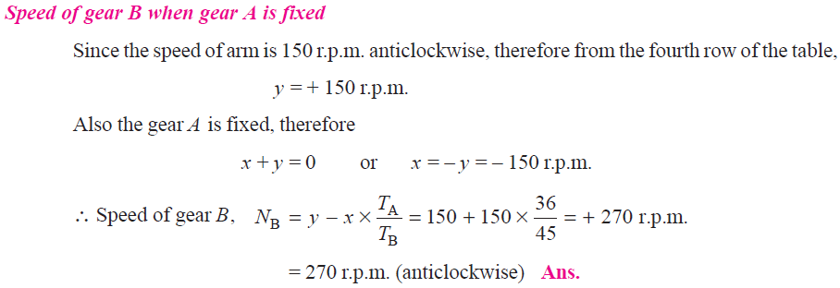
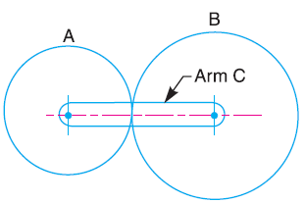
Theory of machines Wessam Al Azzawi

Slide 33
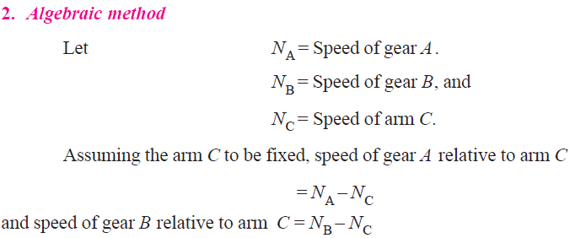
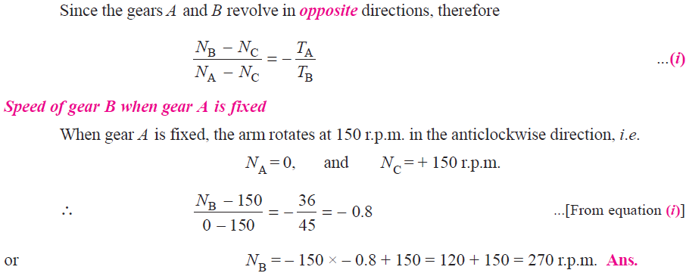
Theory of machines Wessam Al Azzawi

Slide 34
Theory of machines Wessam Al Azzawi

Slide 35
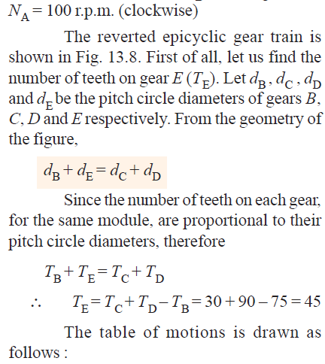
Theory of machines Wessam Al Azzawi

Slide 36
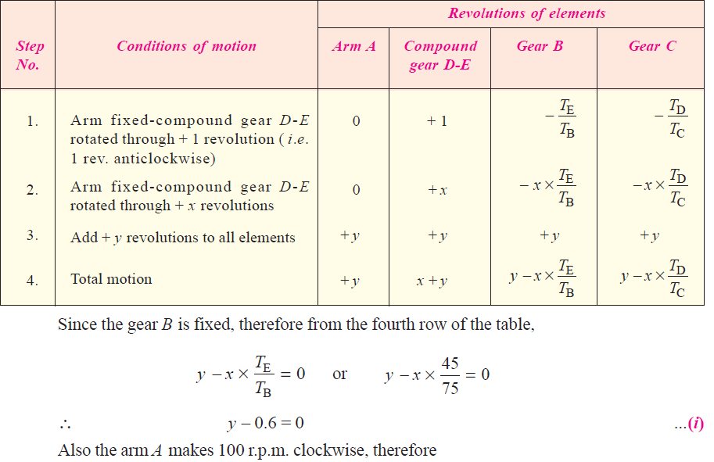
Theory of machines Wessam Al Azzawi

Slide 37
Theory of machines Wessam Al Azzawi

